Slide 1
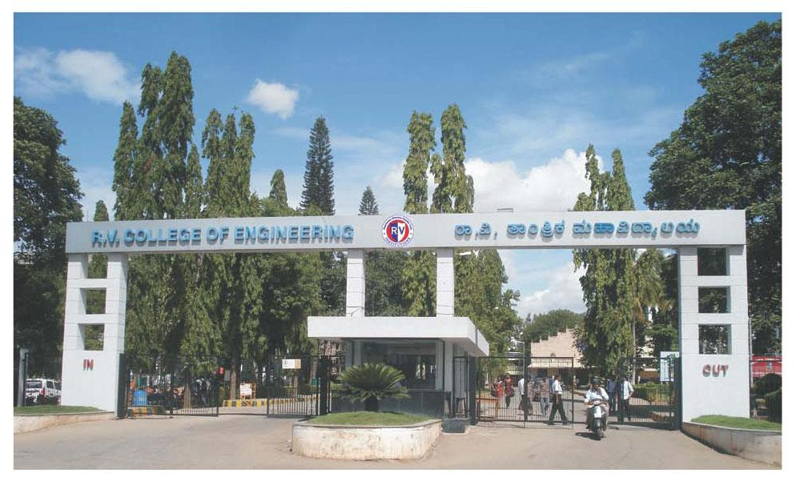
INTERDISCIPLINARY PHASE-2
Topic : Real Time Cashew Kernel Classification using Deep Learning
Internal Guide
Dr. Veena Devi S .V
Associate Professor
Department of Electronics & Communication Engineering

Slide 2
Problem Statement and Objectives
Problem Statement:
To develop an efficient and scalable cashew segregation system that can accurately classify cashew kernels according to their respective grades, overcoming challenges related to real-time processing, image quality, hardware limitations, defect detection, and dataset constraints.
Objectives:
✅ Develop an image processing system to capture raw cashew kernel images and perform data preprocessing.
✅ Design and implement algorithms for feature extraction, data analysis, and classification of kernel variations.
✅ Apply AI techniques to accurately detect, classify, cashew kernels.
⌛ Integrate reliable hardware and software components for efficient, real-time testing and grading.

Slide 3
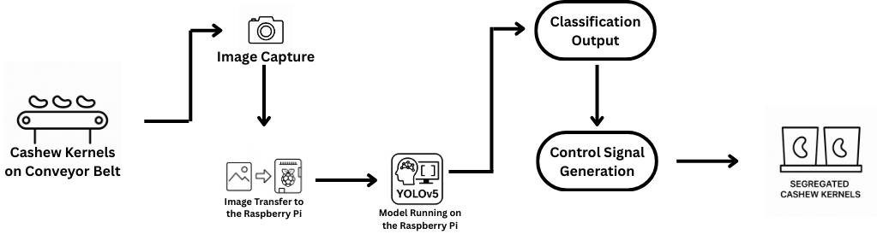
Block Diagram/Methodology
Fig : Proposed system for Real time Cashew classification

Slide 4
Tools & Techniques
Python :
Core Model Development And Image Processing Task.
OpenCV :
For image preprocessing, enhancement, and feature extraction(grades is size,Bounding box dimensions Aspect ratio (width vs height), sharp).
Albumentations:
A fast and flexible Python library used to apply image augmentations like rotation, flipping, brightness changes, and noise to improve model robustness.
Annotation Tool Used
Platform: Roboflow
Annotation Type: Bounding Boxes
Export Format: YOLO v5 (.txt) format
Annotation Method: Manual drawing with class labels.

Slide 5
Tools & Techniques
Raspberry Pi 4 :
Compact single board computer used to run the model and to control hardware.
Web Cam(Microsoft lifecam):
Used for Data Acquisition and also for capturing real time video for cashew grading.
Arduino Uno:
Used to drive the motors for both conveyor belt and the actuators.
Stepper Motor and Motor Drivers(L298N)

Slide 6
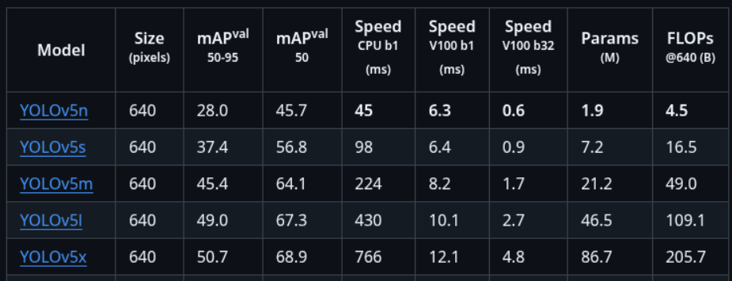
Tools & Techniques
YOLO V5:
YOLO v5 (You Only Look Once v5) is a state-of-the-art deep learning model used for real-time object detection.

Slide 7
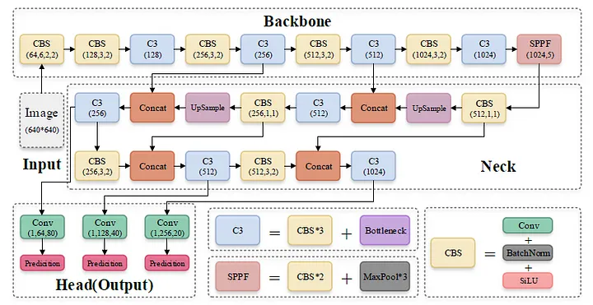

Slide 8
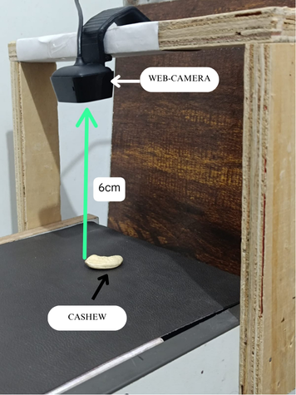
Work Progress so far
Image Acquisition:
The initial phase of the workflow involves image acquisition, wherein images of cashew nuts are captured by positioning the camera at a precisely calibrated height (6CM) to ensure consistency and optimal clarity.
Images Captured
GRADES | NO. OF IMAGES | RESOLUTION
W180 | 250 | 1280X800
W300 | 250 | 1280X800
W500 | 251 | 1280X800

Slide 9
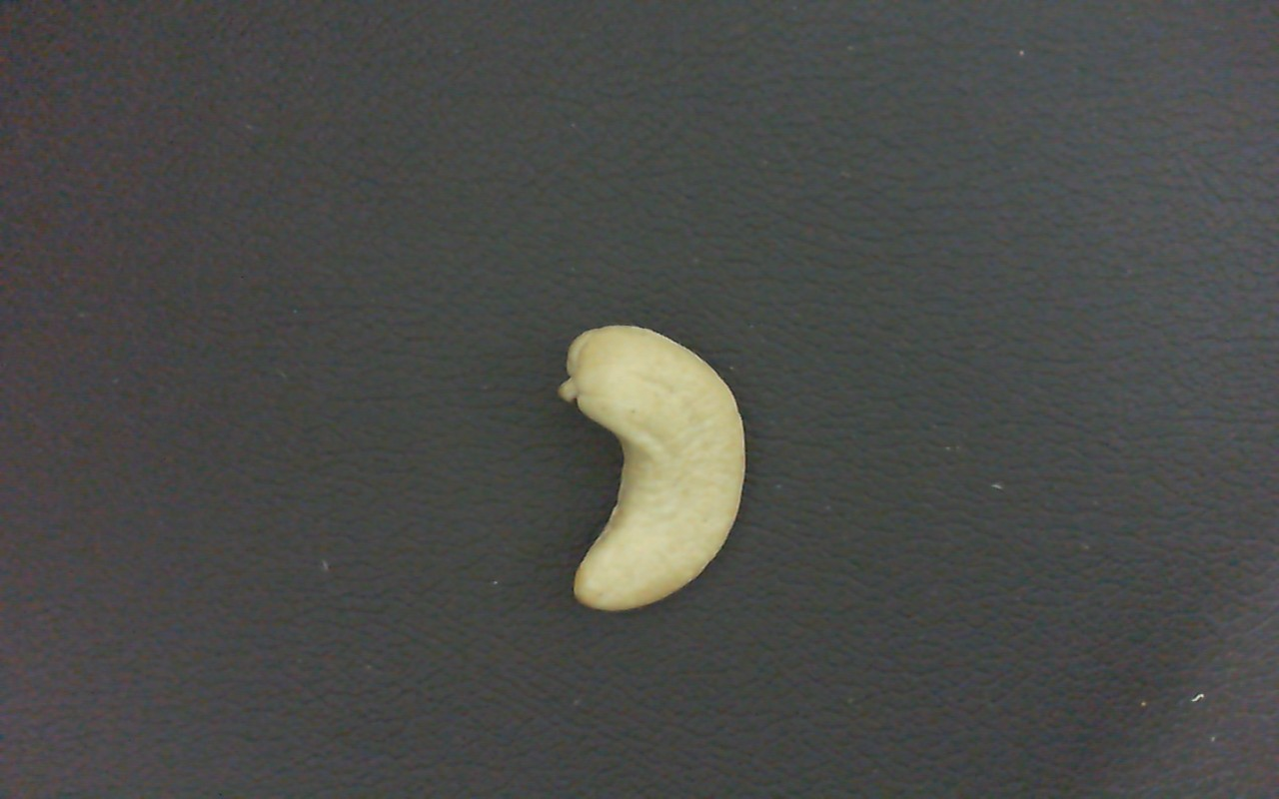
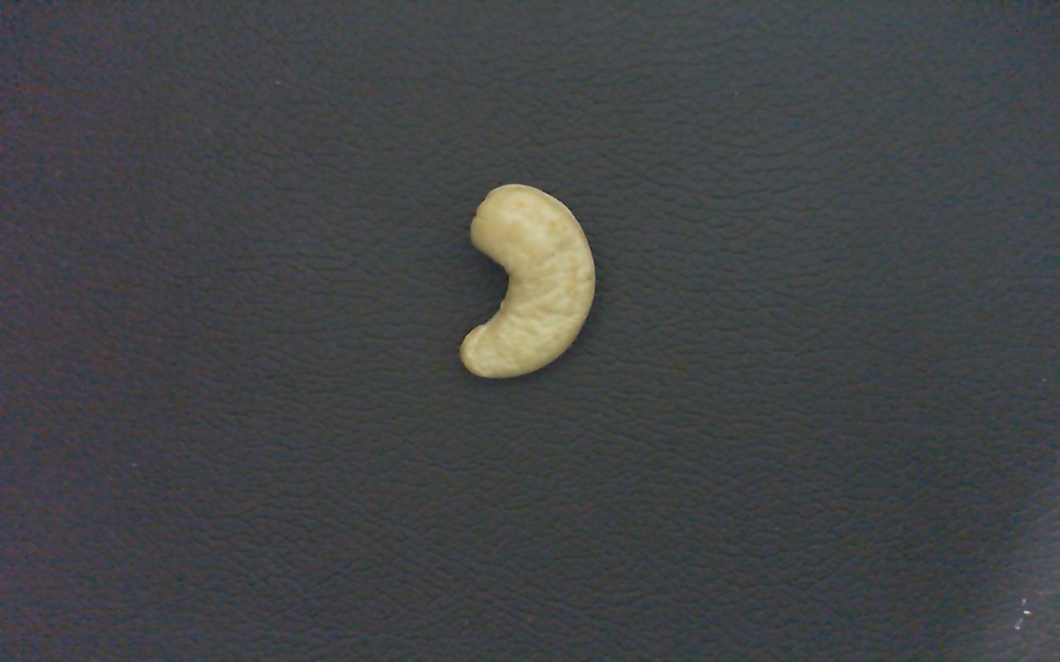
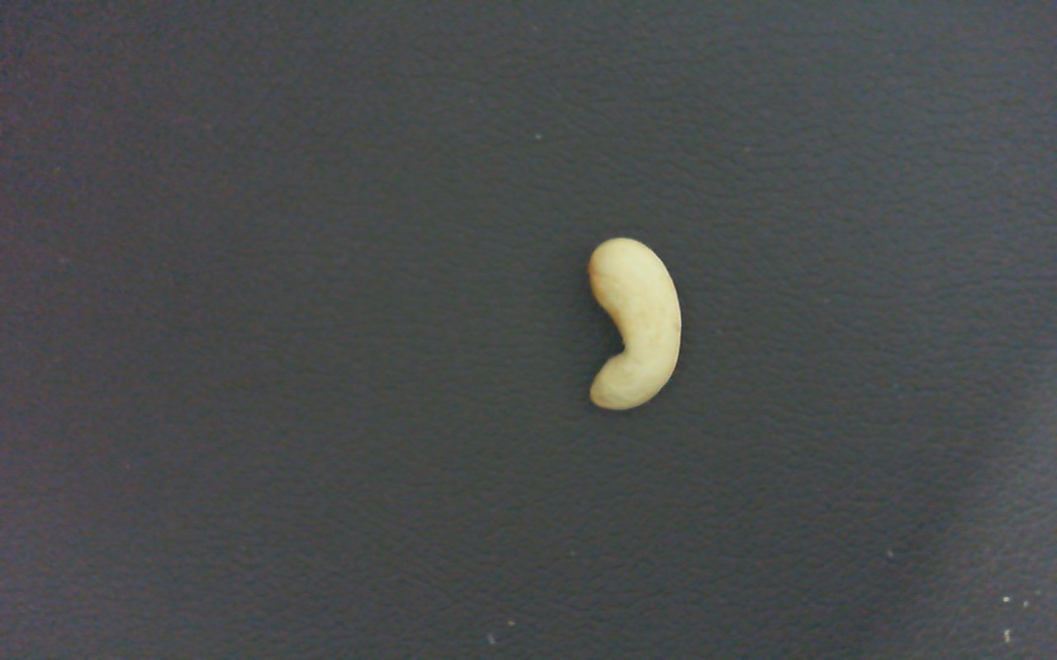
Work Progress so far
Image Acquisition:
Data Sample
W180
W300
W500

Slide 10
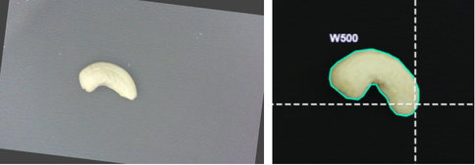
Work Progress so far
2. Image Preprocessing:
Initial preprocessing steps such as:
resizing ( resized to 640x640)
noise reduction
image enhancement
Data Augmentation
have been implemented to improve the quality of input data for Model Training .

Slide 11
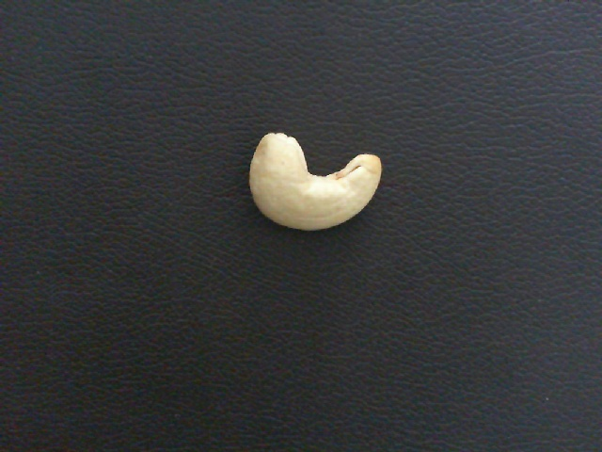

Work Progress so far
Noise Reduction
To enhance image quality and minimize unwanted artifacts, noise reduction was performed using the Gaussian filtering algorithm.
It applies a Gaussian function (a bell-shaped curve) to blur the image.
This is done by averaging each pixel's value with its neighbors, with closer pixels weighted more heavily.
It effectively removes high-frequency noise (random variation in brightness or color).

Slide 12
Work Progress so far
Image Enhancement:
it used to improve the visual quality of an image or make certain features more distinguishable for further analysis.
It helps in making key features (like cracks, textures, or object boundaries) more visible and easier to detect, especially in applications like cashew grading, medical imaging, or surveillance.

Slide 13
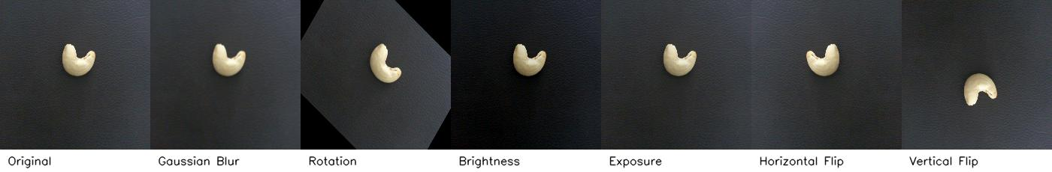
Work Progress so far
Augmentation Settings
Techniques Applied:
💧 Blur: Gaussian blur applied up to 5 pixels
🔁 Rotation: Random angle between -45° to +45°
💡 Brightness: Adjusted randomly between -25% to +25%
🌗 Exposure: Adjusted between -10% to +10%
🔄 Flip: Horizontal, Vertical

Slide 14
Work Progress so far
3. Apply AI techniques(YOLO v5):
Deep learning techniques have been applied to train a model that can detect, classify, and grade cashew kernels based on the extracted features.
The model has been validated on test images, showing promising results in distinguishing between kernels grades into appropriate categories.
Dataset Setup
Total Images: 1500+
Classes: W180, W300, W500
Split:
Training: 70%
Validation: 30%

Slide 15
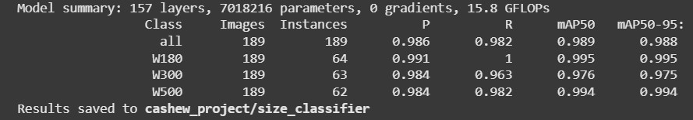
Work Progress so far
Training Parameters
Image Size: 640x640
Epochs: 100
Batch Size: 16
Learning Rate: 0.01
Model Used: YOLO 5S

Slide 16
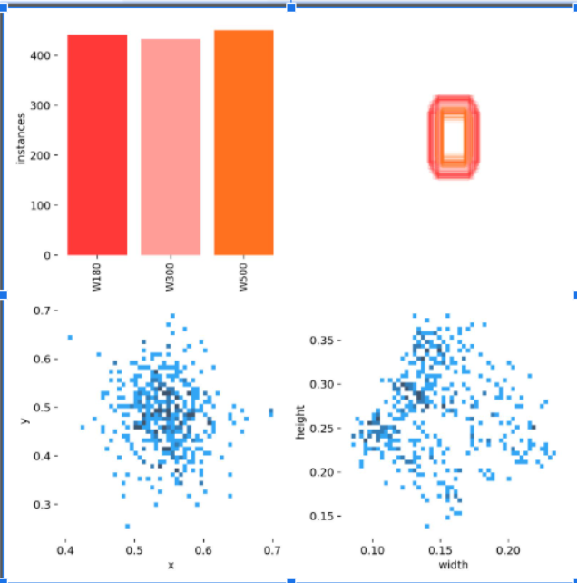
Work Progress so far(YOLO V5)
The top left plot shows represent the number of instance of each labeled
Top right plot represent the Bounding Box heatmap(yellow:few bounding box overlap ; orange : moderate box overlap; red:High)
The stacked, closely aligned rectangles show that the cashews across all classes (W180, W300, W500) are similar in size.
The bottom left represent Scatter plot of normalized center points (x, y) of all bounding boxes.The cluster is tight around (0.5, 0.5) → confirms that most objects are placed near the center of the image.
Scatter plot of normalized width vs height of bounding boxes.Shows variability in object size, but clusters around:
Width ≈ 0.13–0.16
Height ≈ 0.25–0.30

Slide 17
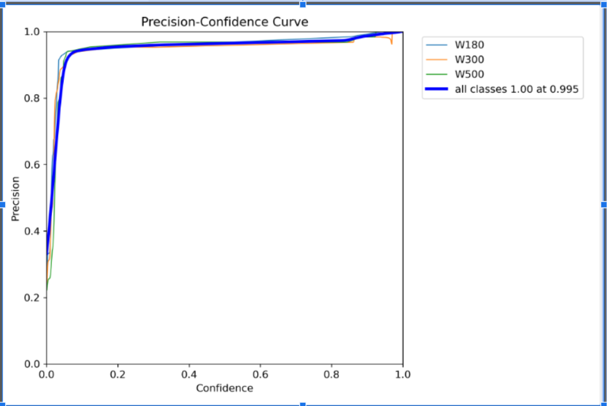
Work Progress so far(YOLO V5)
Precision increases as confidence increases, as the model becomes more certain.
At confidence threshold ≈ 0.975, model achieves perfect precision (1.00) across all classes.
Curves are smooth and converge at the top, indicating very low false positive rates.
The model maintains >90% precision even at low thresholds (0.2 to 0.9), which shows strong base performance.
precision-confidence Curve of YOLO v5s

Slide 18
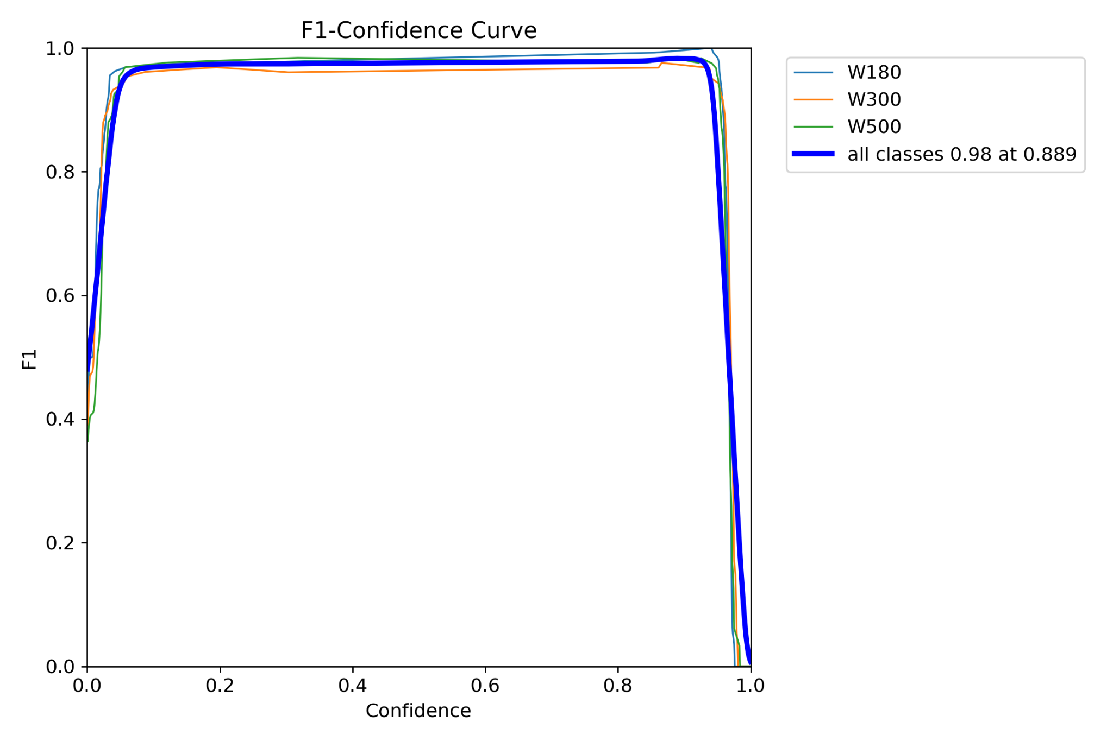
Work Progress so far(YOLO V5)
All three cashew grades (W180, W300, W500) show high F1-scores (close to 1) over a broad confidence range.
Optimal threshold (confidence = 0.889) yields maximum performance (F1 = 0.98) across all classes.
The curve is flat and high across 0.1 to 0.9, indicating that the model is robust and stable to confidence changes.
Sharp drop near confidence = 1 shows that too much confidence filtering removes even correct predictions.
F1-confidence Curve of YOLO v5s

Slide 19
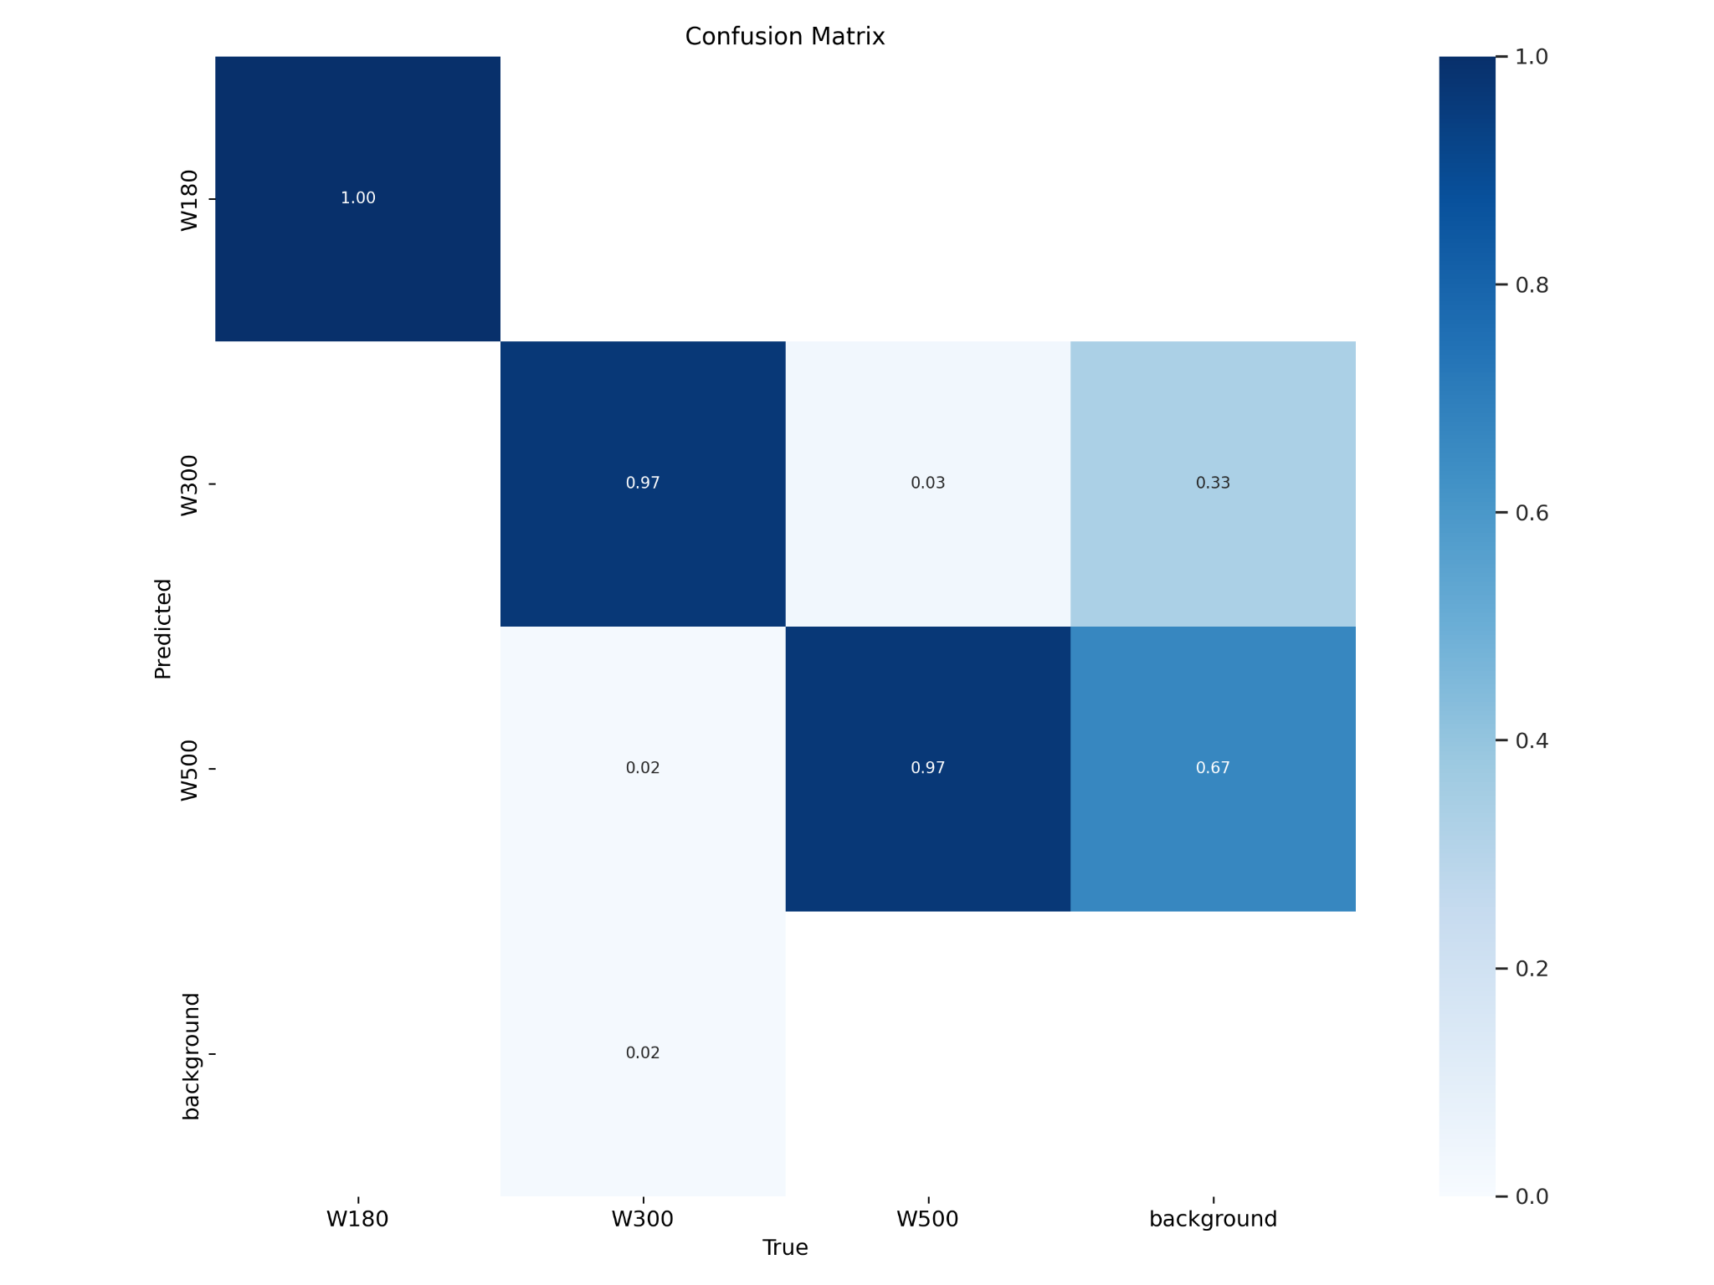
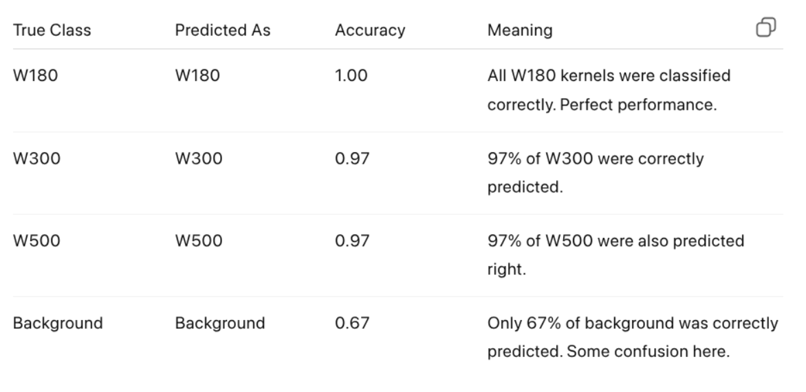
Work Progress so far(YOLO V5)

Slide 20
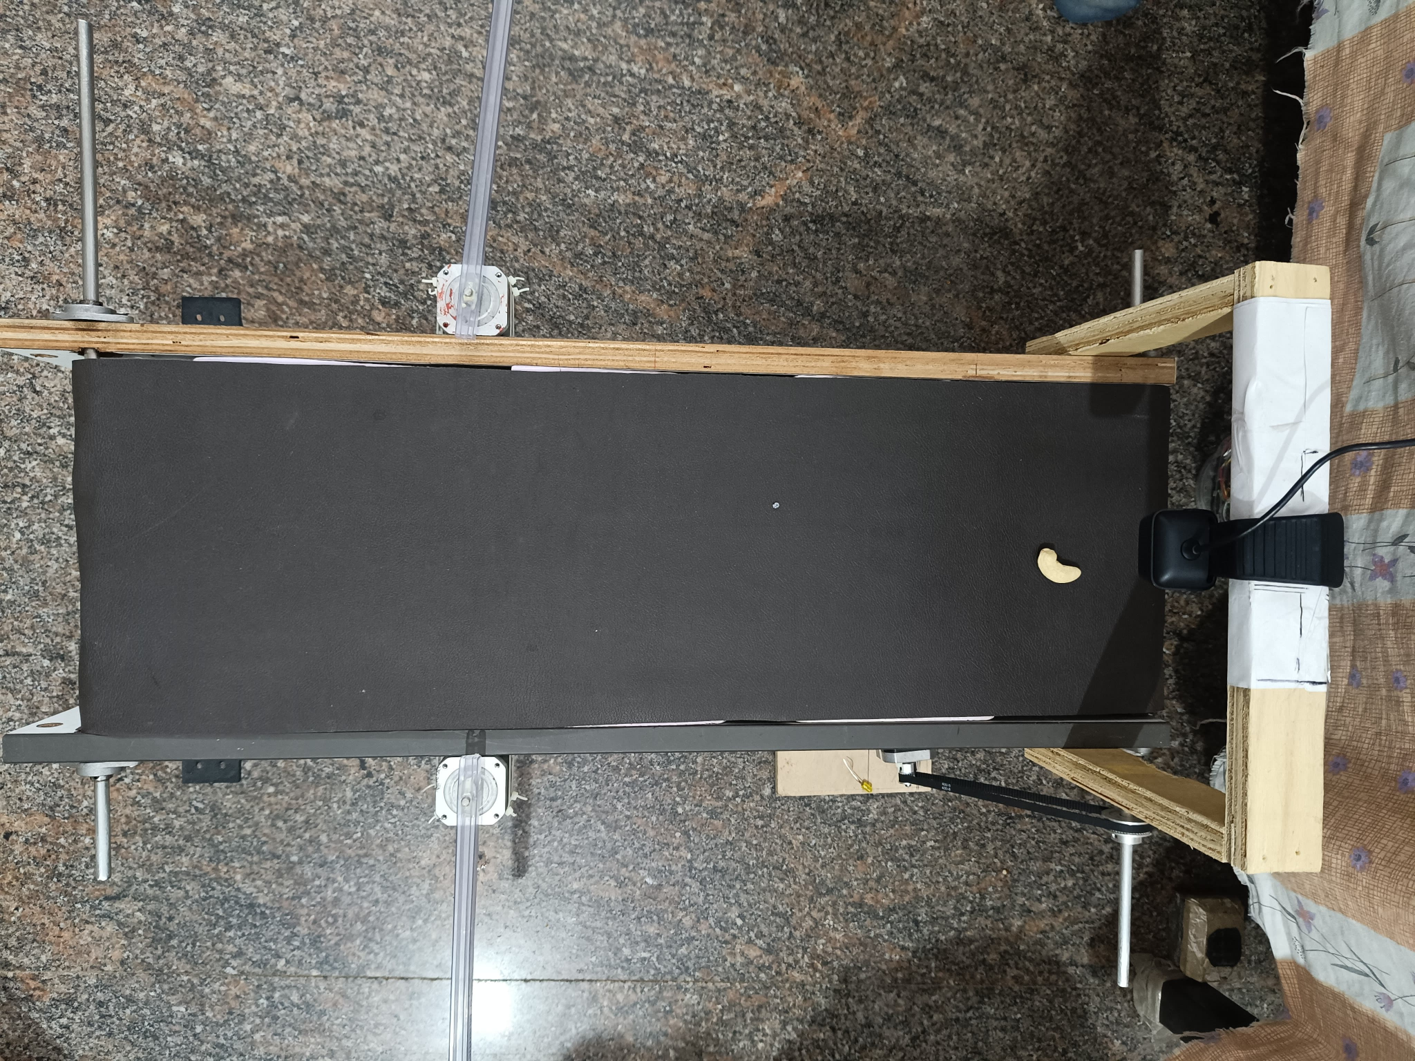
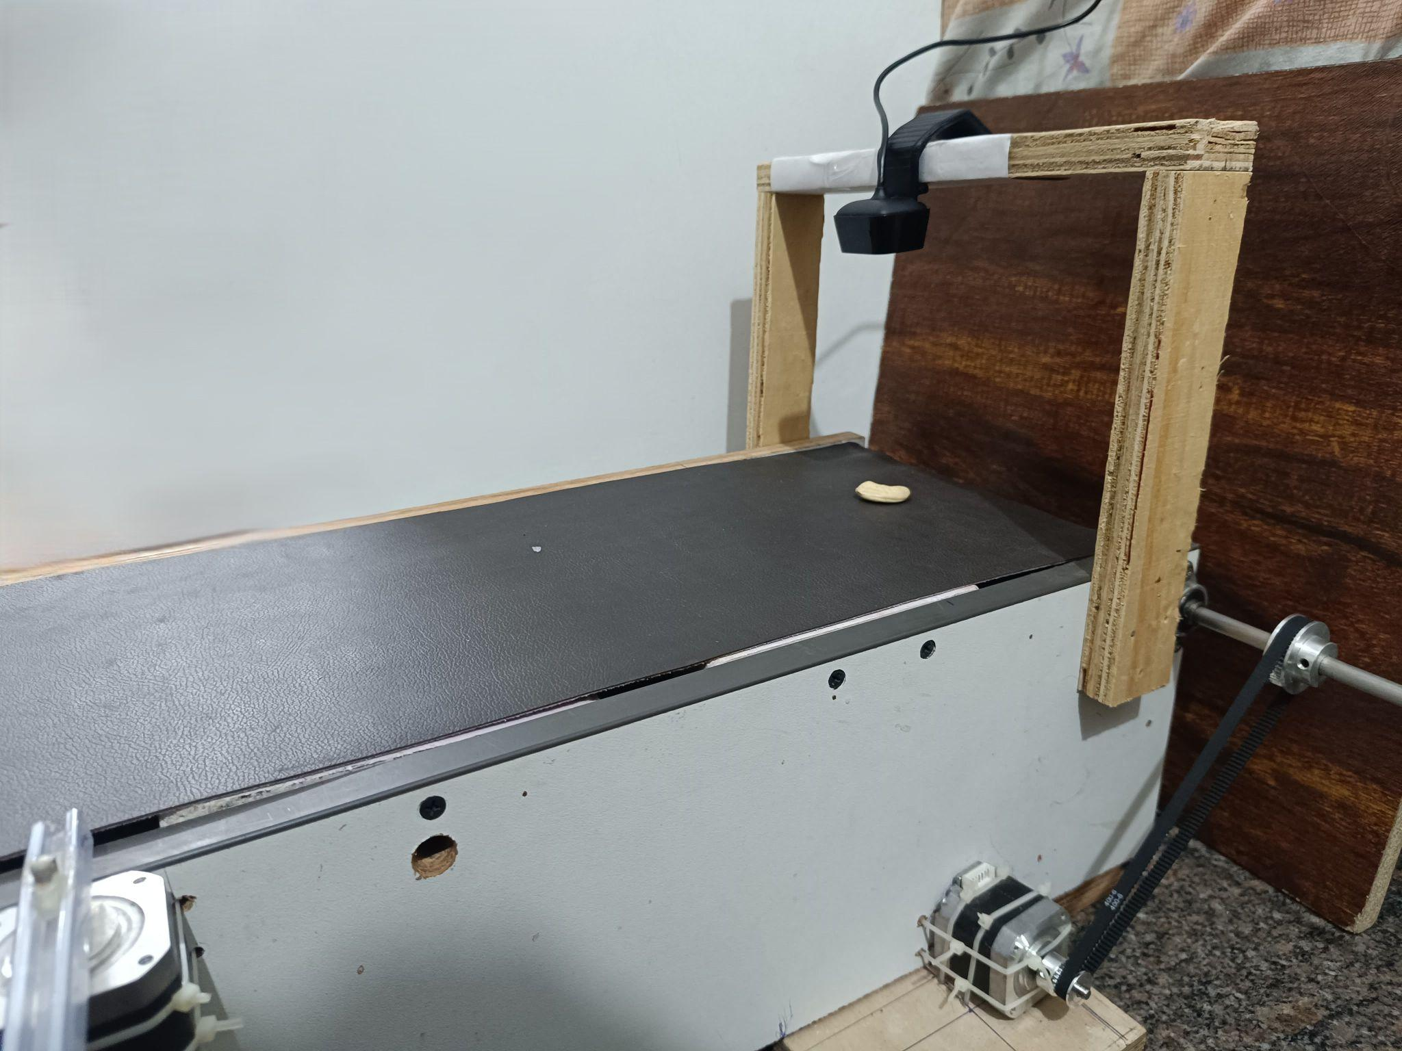
Work Progress so far
Hardware System:

Slide 21
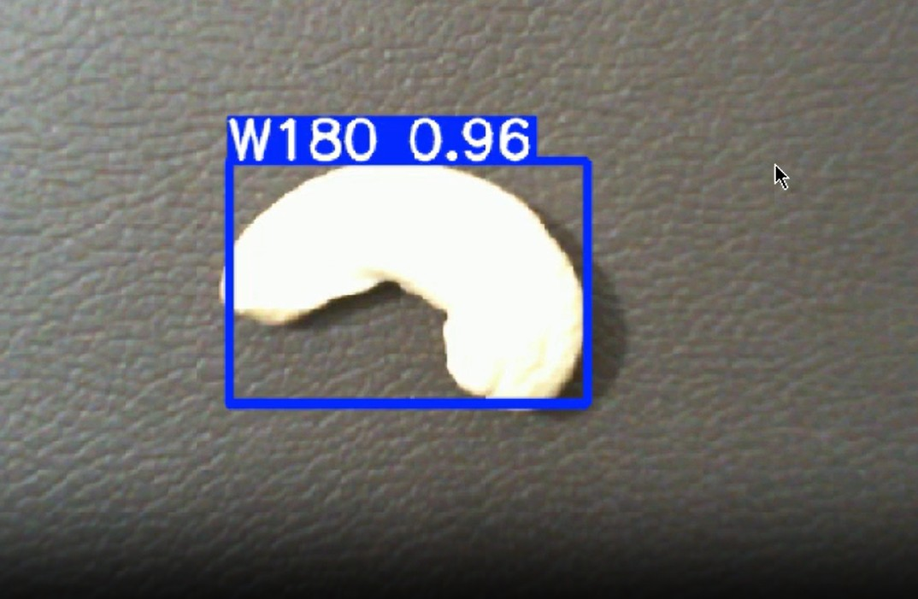
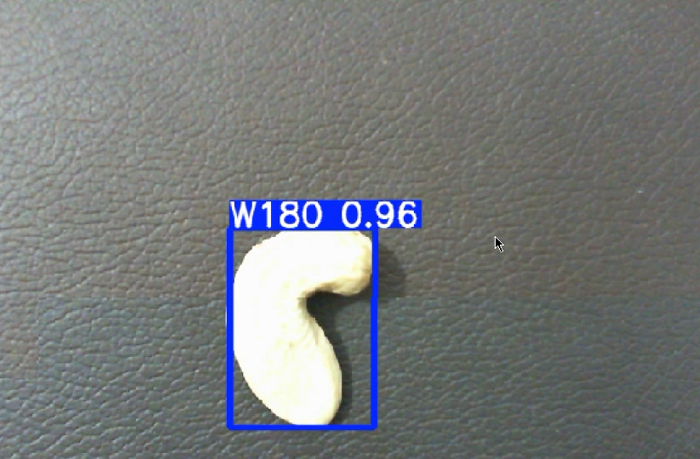
Partial Results

Slide 22
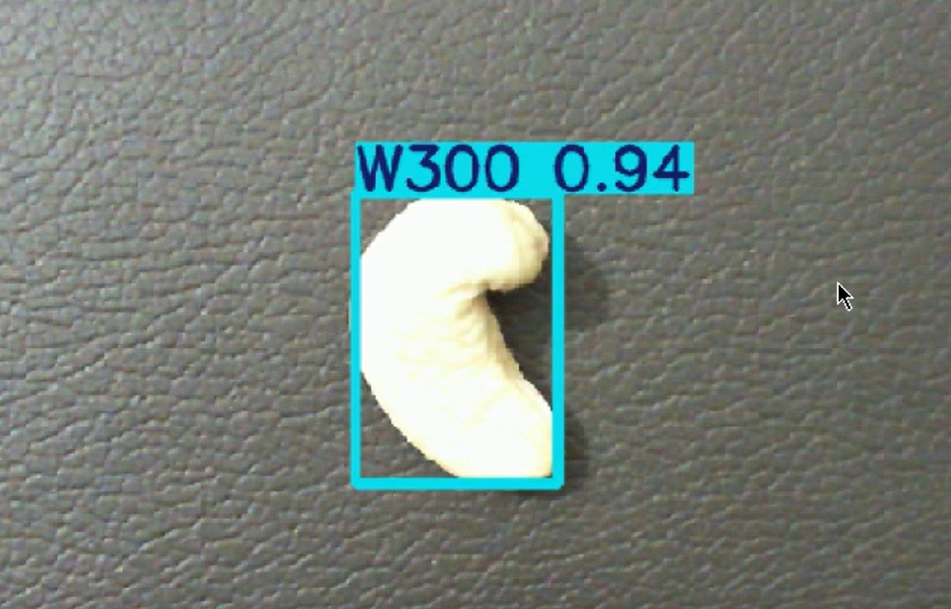
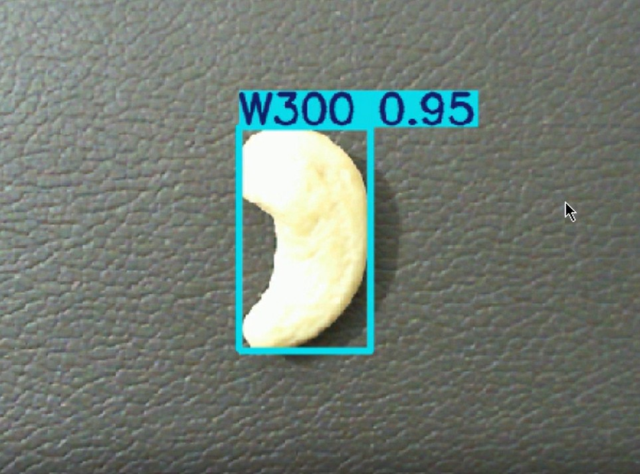
Partial Results

Slide 23
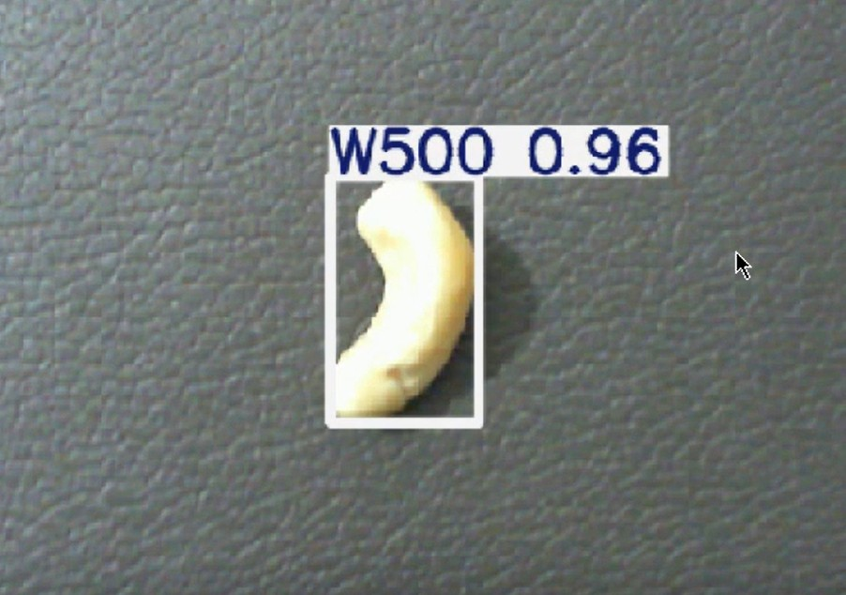
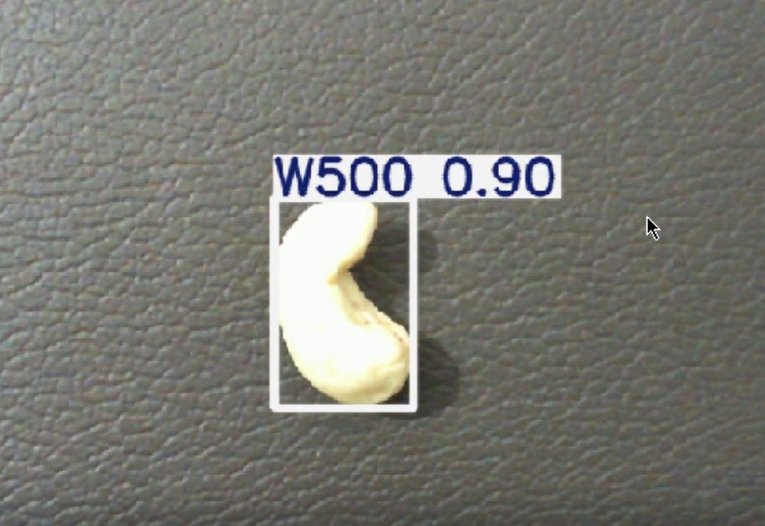
Partial Results

Slide 24
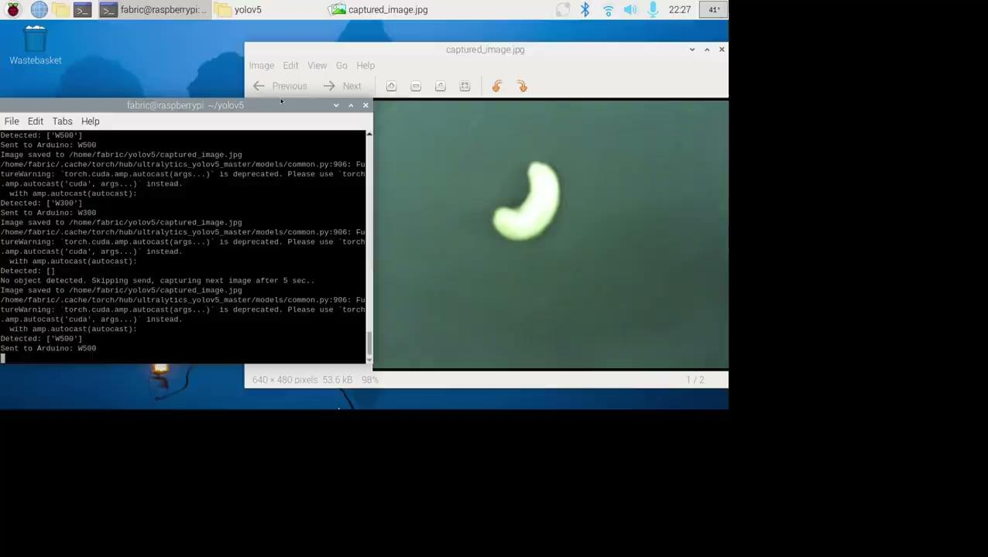
Partial Results

Slide 25
Work to be done for Completion
The system should reliably separate split (broken) kernels from whole kernels in real time. It should then grade the whole kernels by size, and shape using the deep learning model.
Enhancing YOLO model by training with more and diverse Dataset.

Slide 26
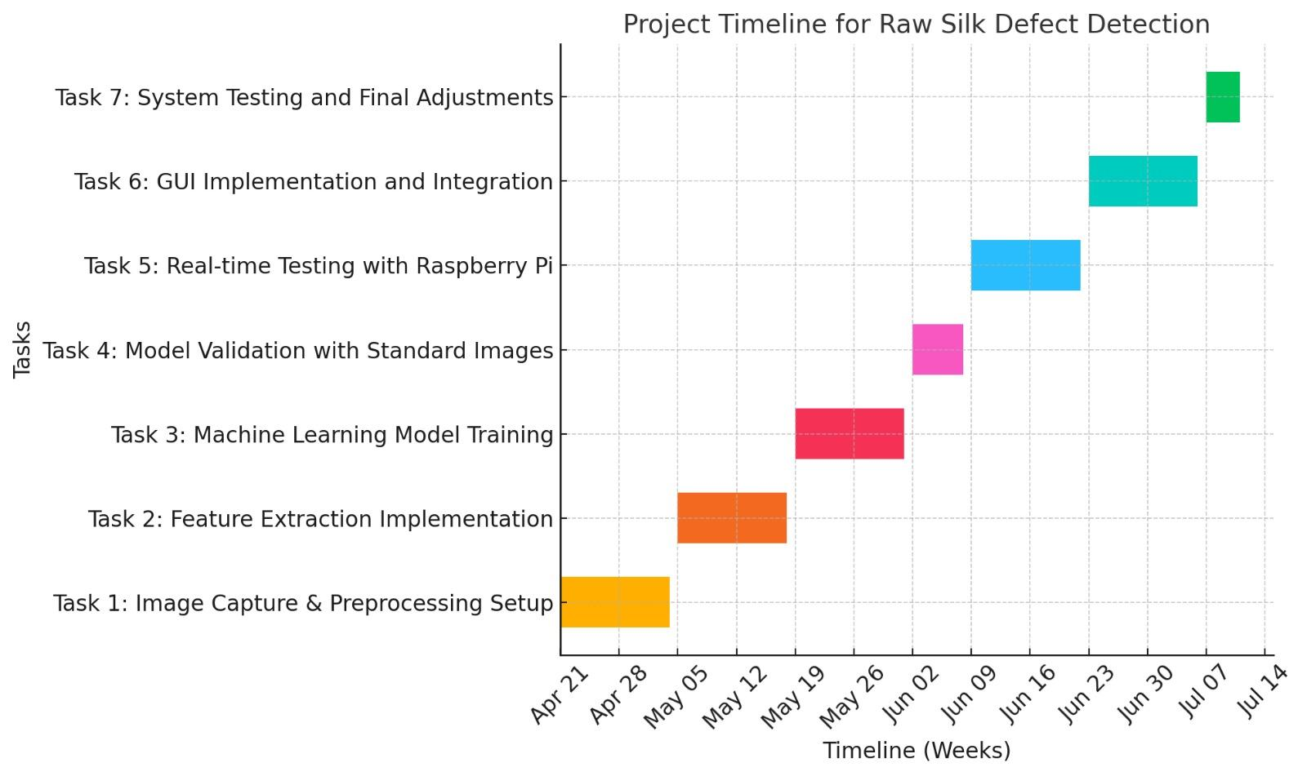
TIMELINE
Work pending
Work Done

Slide 27
REFERENCES
A. Sivaranjani, S. Senthilrani, B. Ashokumar, and A. Senthil Murugan, "An Improvised Algorithm For Computer Vision Based Cashew Grading System Using Deep CNN," in 2018 IEEE International Conference on Current Trends in Advanced Computing (ICCTAC), pp. 1-6, July 2019.
Arun M O, Aneesh G Nath, and Shyna A, "Automated Cashew Kernel Grading Using Machine Vision," in 2016 International Conference on Next Generation Intelligent Systems (ICNGIS), IEEE, pp. 1-6, 2018.
A. Sivaranjani, S. Senthilrani, B. Ashokumar, and A. Senthil Murugan, "CashNet-15: An Optimized Cashew Nut Grading Using Deep CNN and Data Augmentation," in Proceedings of International Conference on Systems Computation Automation and Networking (ICSCAN), IEEE, pp. 1-6, 2019.
Shyna A and Reena Mary George, "Machine Vision based Real Time Cashew Grading and Sorting System using SVM and Back Propagation Neural Network," in 2017 International Conference on Circuits Power and Computing Technologies (ICCPCT), IEEE, pp. 1-6, 2017.
Pham, V.-N., Do Ba, Q.-H., Tran Le, D.-A., Nguyen, Q.-M., Do Van, D., & Nguyen, L., "A Low-Cost Deep-Learning-Based System for Grading Cashew Nuts," Computers, vol. 13, no. 3, p. 71, 2024.
Raj, R., Nagaraj, S.S., Ritesh, S., Thushar, T.A. and Aparanji, V.M.,Fruit Classification Comparison Based on CNN and YOLO. In IOP Conference Series: Materials Science and Engineering (Vol. 1187, No. 1, p. 012031). IOP Publishing,2021.

Slide 28
REFERENCES
7. M. A and P. N. Renjith,Classification of Durian Fruits based on Ripening with Machine Learning Techniques,2020 3rd International Conference on Intelligent Sustainable Systems (ICISS), Thoothukudi,pp. 542-547,
8. S. N. Karnam, V. S. Vaddagallaiah, P. K. Rangnaik, A. Kumar, C. Kumar, and B. M. Vishwanath, "Precise Cashew Classification using Machine Learning," Engineering, Technology & Applied Science Research, vol. 14, no. 5, pp. 17414–17421, Oct. 2024, doi: 10.48084/etasr.8052
9. V. Gautam, R. G. Tiwari, A. Misra, D. Witarsyah, N. K. Trivedi and A. K. Jain, Dry Fruit Classification Using Deep Convolutional Neural Network Trained with Transfer Learning,2023 International Conference on Advancement in Data Science, E-learning and Information System (ICADEIS,pp. 1-6, doi: 10.1109/ICADEIS58666.2023.10270982,2023.
10. S. E. Sunday, R. Ji, A. N. Abdalla and H. Bian,Fruit Image Classification using the Inception-V3 Deep Learning Model,2023 International Conference on the Cognitive Computing and Complex Data (ICCD),pp. 227-230, doi: 10.1109/ICCD59681.2023.10420760,2023.
11. P. Nirale and M. Madankar, Analytical Study on IoT and Machine Learning based Grading and Sorting System for Fruits,2021 International Conference on Computational Intelligence and Computing Applications (ICCICA), Nagpur, India, 2021, pp. 1-6, doi: 10.1109/ICCICA52458.2021.9697161,2021.

Slide 29


